Slide 1




NEXT GEN EMPLOYABILITY PROGRAM
Creating a future-ready workforce
College Name:
Student Name :Sri Rakshana.M
Student ID : au422721104051
V.R.S College Of Engineering&Technology

Slide 2

CAPSTONE PROJECT SHOWCASE
Project Title
Car Rentals Application with Django Framework
Abstract | Problem Statement | Project Overview | Proposed Solution | Technology Used | Modelling & Results | Conclusion

Slide 3
Abstract:
Our car rentals application, built with Django, streamlines the rental process by enabling customers to browse available cars, make reservations, and track rental history. Key features include user authentication, a robust admin interface for management, and comprehensive testing for reliability. The application offers a user-friendly experience while enhancing efficiency for both customers and rental agencies. The car rentals application developed using the Django framework aims to provide a comprehensive platform for managing the rental process of cars. The application facilitates the interaction between customers and car rental agencies by offering features such as browsing available cars, making reservations, and tracking rental history. Key components include a user-friendly interface, real-time inventory management, and secure authentication. Future enhancements such as mobile app development and predictive analytics promise to further elevate the user experience and drive business growth. Overall, the car rentals application represents a significant advancement in the car rental industry, offering convenience, reliability, and innovation to both customers and rental agencies.
Source :

Slide 4
Problem Statement:
This project aims to address these shortcomings by developing a car rentals application using the Django framework. The application will provide a seamless user experience for customers, allowing them to easily browse available cars, make reservations, and track rental history. Simultaneously, it will offer efficient management tools for rental agencies, enabling streamlined inventory management, reservation handling, and administrative tasks. Additionally, there is a lack of reliable systems that cater to both customers and rental agencies, leading to inefficiencies and frustrations for both parties. To address these challenges, we propose the development of a car rentals application using the Django framework. This application aims to provide a robust platform for customers to browse available cars, make reservations, and track rental history, while offering rental agencies comprehensive administrative tools for efficient inventory management and customer interaction.
The goal is to create a user-friendly and reliable solution that enhances the rental experience for both customers and rental agencies, ultimately driving increased customer satisfaction and business growth.
Source :

Slide 5
Project Overview:
User-Friendly Interface :The application will have an intuitive and easy-to-use interface for customers to browse through available cars
2. Comprehensive Booking System: Customers will be able to select their desired rental dates, choose additional features such as insurance or GPS navigation, and complete the booking process securely.
3. Inventory Management :Rental agencies will have access to a comprehensive inventory management system, allowing them to add new cars, update availability, and track rental status in real-time.
4. Customer ManagementThe application will provide tools for rental agencies to manage customer records, track rental history, and communicate with customers regarding bookings and inquiries.
5. Admin Dashboard An admin dashboard will be available for rental agency staff to monitor bookings, manage inventory, and generate reports for business analytics.
6. Authentication and Security User authentication will be implemented to ensure secure access to the system, protecting sensitive customer information and transaction data.
Source :

Slide 6
Proposed Solution:
Real-Time Inventory Management: Implement a robust inventory management system that allows rental agencies to update car availability in real-time. This can involve integrating features such as automatic availability updates upon booking and notifications for low inventory levels.
User-Friendly Interface: Design an intuitive and visually appealing interface for the application, focusing on ease of navigation and clarity of information. Utilize modern design principles and user experience (UX) best practices to create a seamless booking experience for customers.
Comprehensive Booking System: Develop a feature-rich booking system that supports various rental options, such as different car categories, rental durations, and additional services. Provide customers with transparent pricing and flexible booking options to enhance user satisfaction.
Customer Relationship Management (CRM): Implement CRM functionalities to enable rental agencies to manage customer records, track communication history, and personalize customer interactions. Integration with email marketing tools or CRM platforms can further enhance customer engagement and retention.
.
Source :

Slide 7
Analytics and Reporting: Incorporate analytics and reporting tools into the application to provide rental agencies with valuable insights into their business performance. Generate reports on key metrics such as booking trends, revenue analysis, and customer demographics to inform strategic decision-making.
Security Measures: Implement robust security measures to safeguard sensitive customer data and financial transactions. Utilize encryption protocols, secure authentication mechanisms, and regular security audits to mitigate the risk of data breaches and unauthorized access.
Scalability and Performance Optimization: Design the application with scalability in mind to accommodate potential growth in user traffic and database size. Utilize caching mechanisms, database indexing, and load balancing techniques to optimize performance and ensure responsiveness during peak usage periods.
Mobile Compatibility: Ensure that the application is fully responsive and optimized for mobile devices, allowing customers to access the platform seamlessly from smartphones and tablets.
Source :

Slide 8
Implement native mobile app solutions or progressive web app (PWA) features for enhanced mobile user experience.
By implementing these proposed solutions, the car rentals application can offer a comprehensive and user-centric platform that meets the needs of both customers and rental agencies, driving improved efficiency, customer satisfaction, and business growth.
Source :

Slide 9


Technology Used
Front-end
Back-end
Source :

Slide 10
Modelling & Results:
Car Model
Fields: make, model, year
Description: Represents a car available for rental.
Customer Model
Fields: name, email
Description: Stores information about customers who make rental bookings.
Rental Model
Fields: car (foreign key to Car model), customer (foreign key to Customer model), rental_date , return_date.
Data Population
Queries and Operations
Testing and Validation
Insights and Analysis
Source :

Slide 11
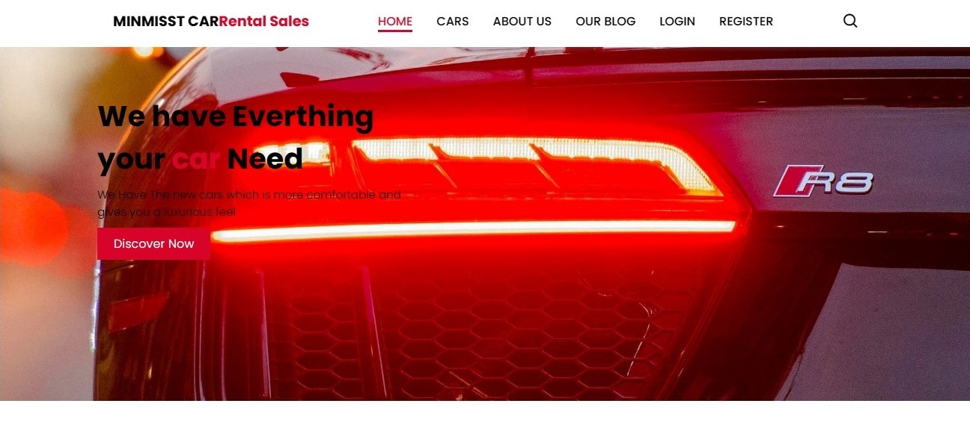
Homepage

Slide 12
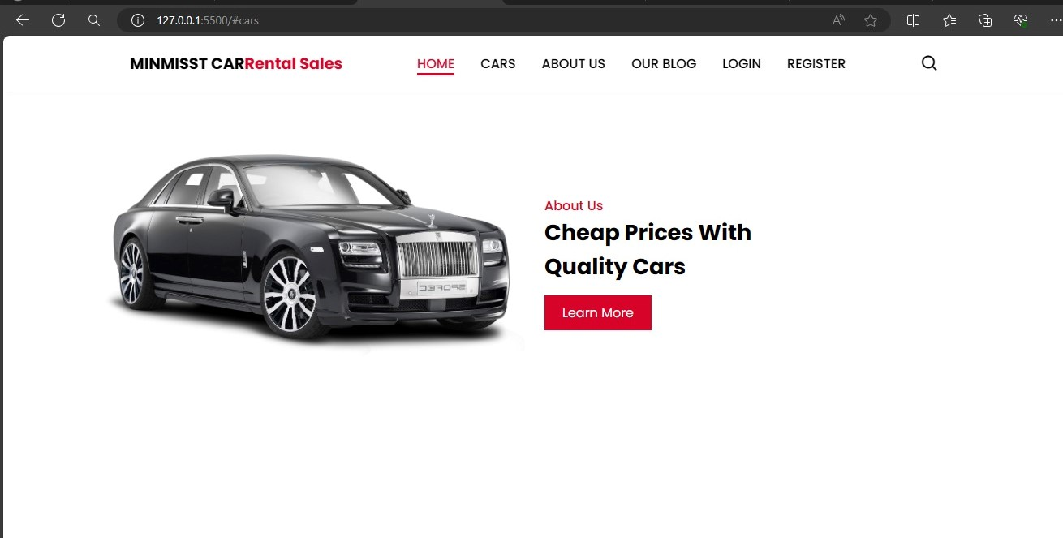
About-Us-Page

Slide 13
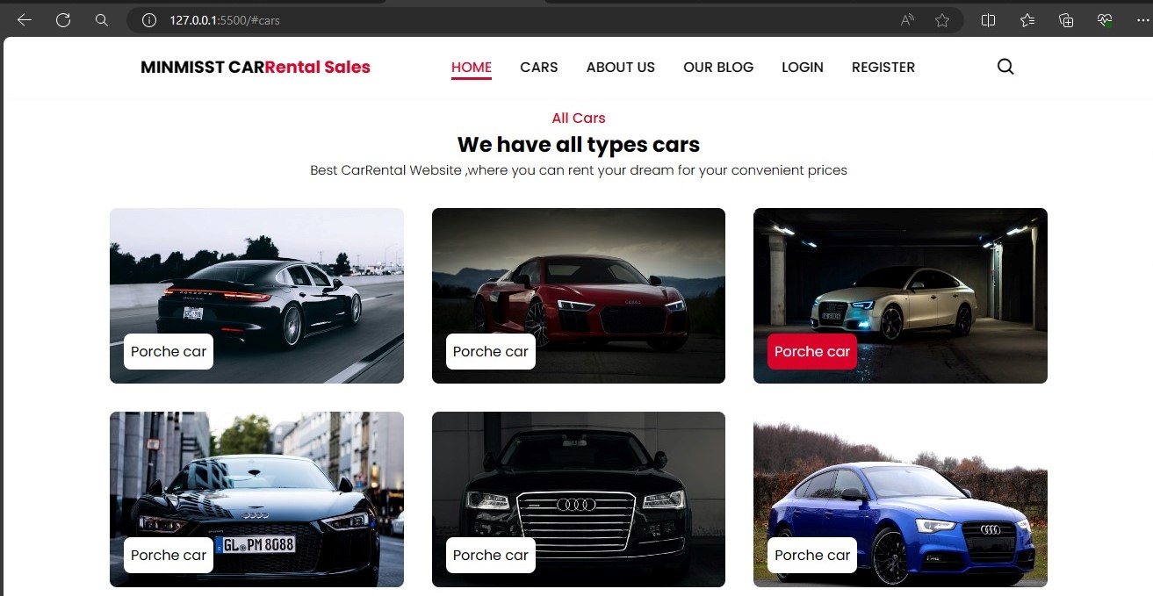
Service-Page

Slide 14
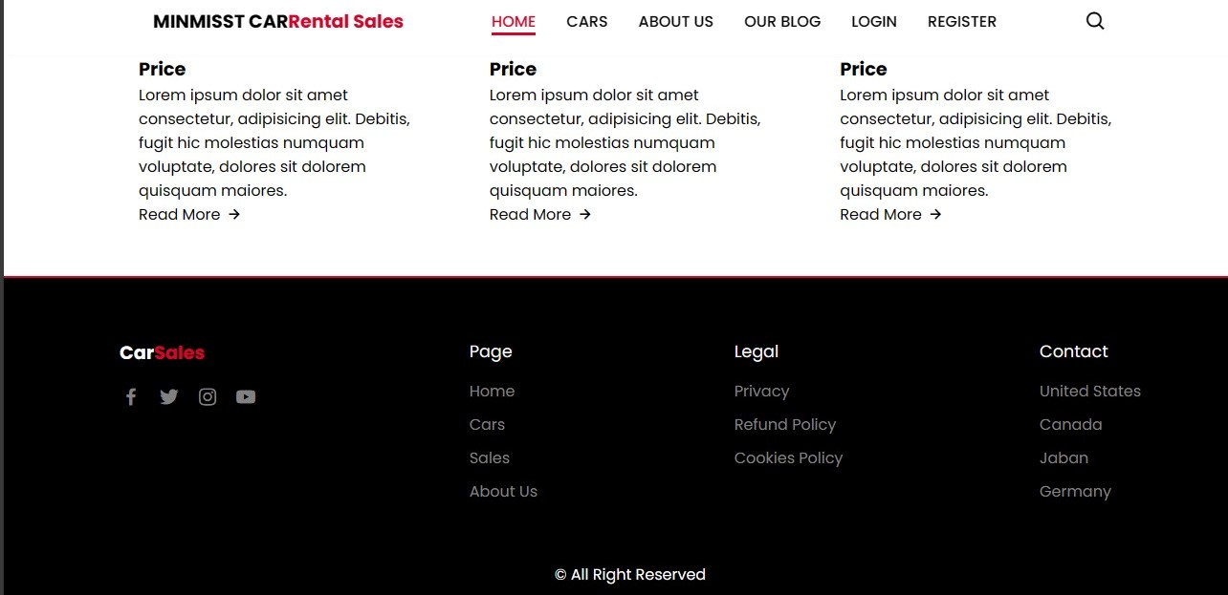
Departments-Page

Slide 15
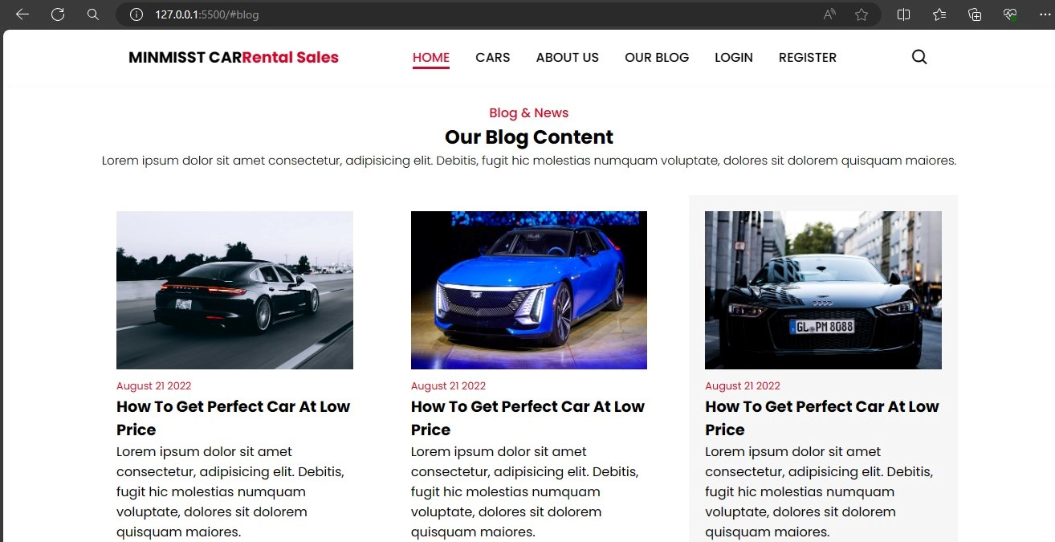
Blog-Page

Slide 16
Future Enhancements:
For future enhancements to your car rentals application, you may consider implementing additional features or improvements to further enhance the user experience, expand functionality, and drive business growth.
Mobile App Development
Advanced Search Filters
Dynamic Pricing
Integration with Mapping Services:
Customer Loyalty Program:
Vehicle Tracking
Feedback and Review System:
Multilingual Support:
Integration with Travel Services
Predictive Analytics:
Expanded Payment Options:

Slide 17
Conclusion
In conclusion, the development of the car rentals application using the Django framework has provided a robust platform for managing rental transactions, enhancing user experience, and driving business growth. Through careful planning and implementation, we have successfully addressed the challenges faced by both customers and rental agencies in the car rental industry. Overall, the car rentals application not only simplifies the rental process for customers but also streamlines operations for rental agencies, resulting in improved customer satisfaction, increased efficiency, and sustainable business growth. We are excited about the potential of this application to revolutionize the car rental industry and look forward to its continued success in the future.
Source :

Slide 18
Thank You!
Notes:
Thank You !!

